Slide 1
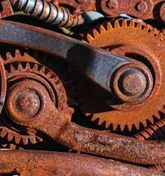
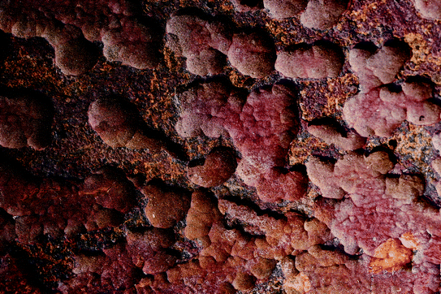
Unit-V
Corrosion
&
Surface Treatment

Slide 2
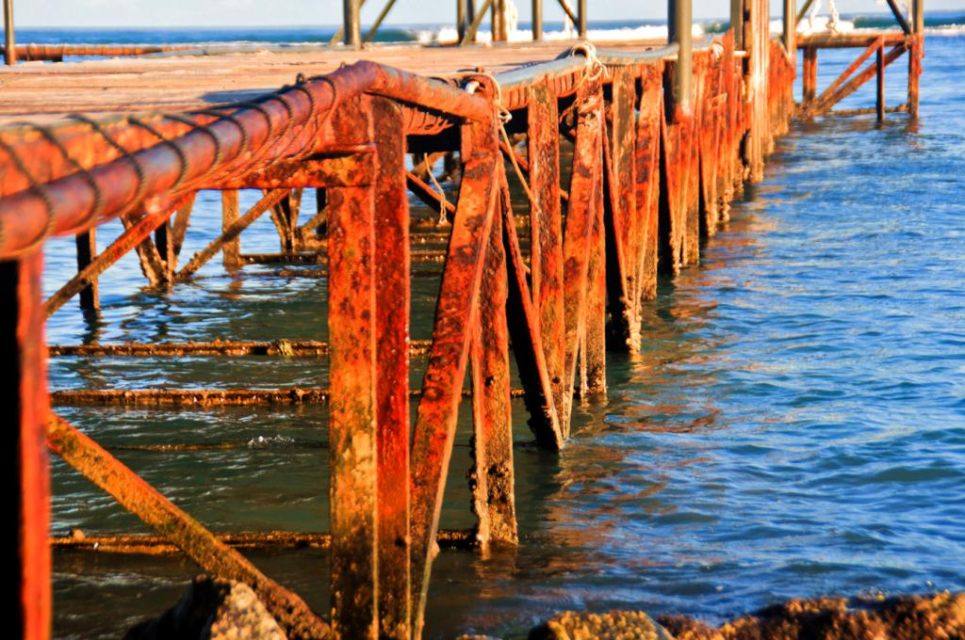
Corrosion:
The spontaneous slow destruction of metals in the course of their chemical, electrochemical or biochemical interactions with the environment is corrosion.
This is exactly the reverse of extraction of metals from ores. Examples are:
Formation of reddish-brown layer of rust (Hydrated ferric oxide) on the surface of iron (Fe₂O₃H₂O).
Formation of green layer (Tarnishing Cupper) of basic carbonates on the surface of copper (CucO₃ + Cu(OH)₂ ).
When a silver comes in contact with oxygen, a black coat is deposited over it due to formation of sulphur dioxide (Tarnishing of silver).
Units: milli inches /years (or) mm/ year.

Slide 3
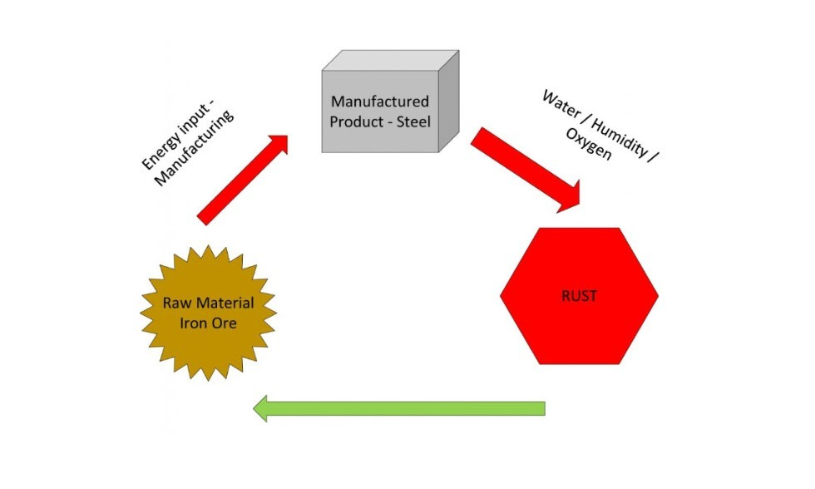
Causes of Corrosion:
Native State: The metals exist as such in the earth crust. These metals are non-reactive in nature. They are with corrosion resistance. Example: Au, Pt, Ag, etc.
Combined State: Other metals are highly reactive undergoes reaction with their environment to form stable ores and minerals. Example: Fe₂O₃, ZnO, PbS.
Extracted from their ores by reducing to pure forms with various processes.
In the pure state, the metals are unstable as they are considered in excited state.
Therefore, as soon as the metals are extracted, the reverse process begins to form stable states.
Hence, when metals are used in various forms, they are exposed to environment, the exposed metal surface begin to decay.
Ores → Pure metal → Corroded metal
(Stable) (unstable) (Stable)

Slide 4
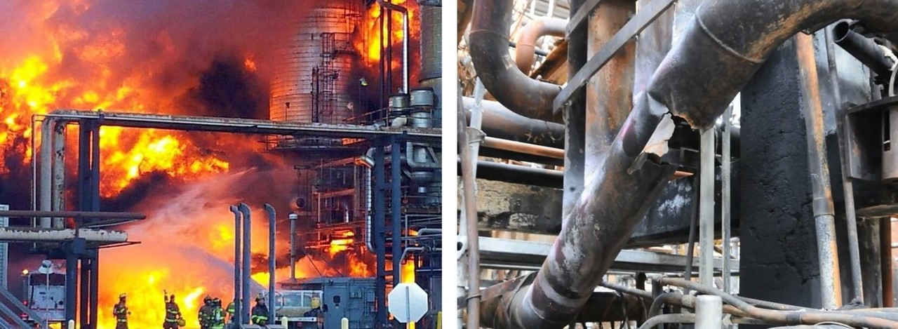
Effects of corrosion:
The metallic properties like conductivity, malleability, ductility etc. are lost due to corrosion.
The efficiency of the machine gets failure leads to plant shut down.
Preventive maintenance like protective coatings is required.
Lose of valuable materials such as blockage of pipes, mechanical damage of underground water pipes
Accidents due to mechanical lose of metallic bridges, cars, aircrafts etc.
Losses occurring due to corrosion cannot be measured in terms of the cost of metals alone, but the high cost of fabrication into equipment.
Hence an engineer must understand the mechanism of corrosion so that the effects can be minimized by avoiding the corrosion conditions and provide simultaneous protection against corrosion.

Slide 5
Types of Corrosion (or) Theories of corrosion
Dry or Chemical Corrosion
Wet or Electrochemical Corrosion
Dry or Chemical corrosion:
It occurs in dry condition in the absence of moisture and liquid electrolyte.
This type of corrosion is due to the direct chemical attack of metal surfaces by the atmospheric gasses present in the environment.
In this homogeneous and heterogeneous metallic surface gets corroded.
It is a slow process and adopts adsorption mechanism.
Corrosion products accumulate at the place of corrosion
Types of Dry or Chemical corrosion:
Corrosion by Oxygen or Oxidation corrosion
Corrosion by Other gasses
Liquid Metal Corrosion

Slide 6
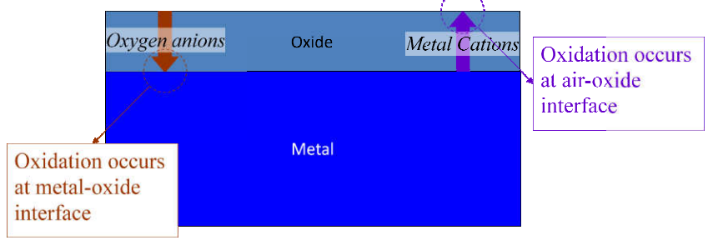
Corrosion by Oxygen or Oxidation corrosion
Oxygen present in atmosphere attacks metal surface resulting in the formation of metallic oxide which is a corrosion product and this is known as oxidation corrosion.
Alkali metals (Li, Na, K, etc.) and alkaline earth metals (Mg, Ca, etc.) are rapidly oxidized at low temperature.
At high temperature almost all metals (except Ag, Au and Pt) are oxidized. Mechanism of oxidation corrosion

Slide 7
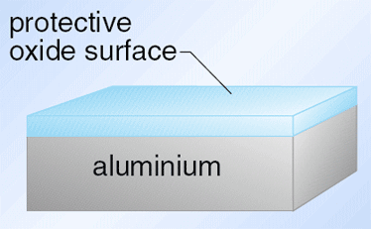
The nature of the metal oxide layer formed plays an important role in determining the extent of further corrosion. The metal oxide formed will be following types:
Stable metal oxides: It is impervious in nature and forms a protective coating, thus preventing the further oxidation of metals. Ex: Al, Pb, Cu, Sn.
Unstable metal oxides: This type of oxide layer decomposes back to metal and oxygen as soon as it is formed. So no oxidation corrosion. Ex: Ag, Au.
Volatile metal oxides: The metal oxide volatizes soon it is formed, leaving the underlying metal exposed for further attack. Thus, rapid corrosion. Ex: Mo.
Porous metal oxides: The oxide layers have pores, cracks and allow the oxygen to access the underlying metal. This results in rapid corrosion. The process continues until the entire metal is converted into its oxides. Ex: Li, Mg, Na.

Slide 8

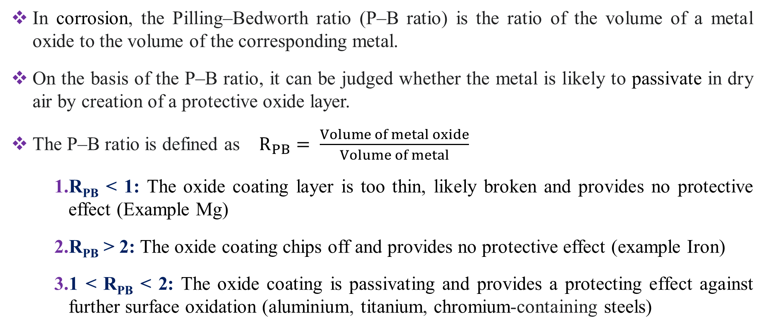
Pilling–Bedworth Rule:
In corrosion, the Pilling–Bedworth ratio (P–B ratio) is the ratio of the volume of a metal oxide to the volume of the corresponding metal.
On the basis of the P–B ratio, it can be judged whether the metal is likely to passivate in dry air by creation of a protective oxide layer.
The P–B ratio is defined as $R_{PB}= \frac{Volume of metal oxide}{Volume of metal}$
R_{PB} < 1: The oxide coating layer is too thin, likely broken and provides no protective effect (Example Mg)
R_{PB} > 2: The oxide coating chips off and provides no protective effect (example Iron)
1 < R_{PB} < 2: The oxide coating is passivating and provides a protecting effect against further surface oxidation (aluminium, titanium, chromium-containing steels)

Slide 9
Corrosion by other gases:
Gases like, SO₂, CO₂, H₂S, F₂ and Cl₂ are also corrosive.
Depending on the chemical environment, these gases react with the metal and forms the corrosion products, which may be protective or non-protective.
Dry chlorine reacts with Ag to form AgCl, which is protective layer.
On the other hand, tin chloride (SnCl₄) is volatile and porous.
In petroleum industries, at high temperature, H₂S attacks steel forming FeS porous scale.
Liquid metal corrosion:
This type of corrosion occurs due to chemical action of flowing liquid metals at high temperature on solid metal or alloy.
In several industries, molten metal passes through metallic pipes and causes corrosion due to dissolution or internal penetration.
For example, liquid mercury dissolves most metals by forming amalgams. Coolant (liquid sodium metal) leads to corrosion of cadmium in nuclear plant.

Slide 10
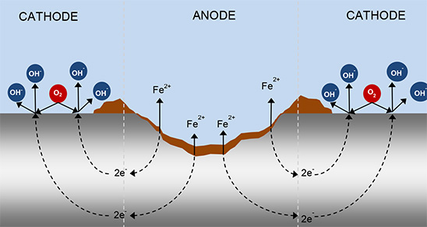
Wet or Electrochemical Corrosion
When metals are exposed to wet (moisture) environment, then undergo corrosion through electrochemical process.
In above conditions, metals lead to form different anodic and cathodic areas on the surface resulting several electrochemical cells.
At anodic area oxidation reaction takes place, so anodic metal is destroyed by dissolving. Hence corrosion always occurs at anodic areas.
At Cathode reduction takes place i.e. involves flow of current between anodic and cathodic areas, so safe from corrosion.
Heterogeneous or bimetallic surfaces alone suitable for this corrosion.
Corrosion is not uniform and occurs at the anode while the products are formed elsewhere.
It follows electrochemical mechanism, so it is a continuous and fast process.

Slide 11
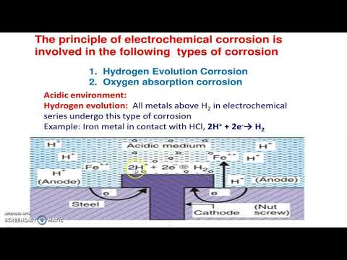
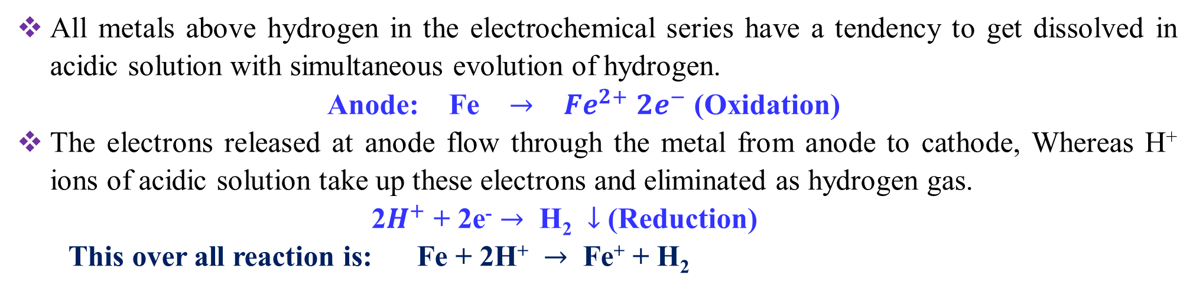
Mechanism of electro corrosion involves two ways.
Evolution of Hydrogen
Absorption of Oxygen
Evolution of Hydrogen: - This type of corrosion occurs in acidic environment. Here the anodes are very large areas, where as cathodes are small areas.
All metals above hydrogen in the electrochemical series have a tendency to get dissolved in acidic solution with simultaneous evolution of hydrogen.
Anode: Fe $→$ ${Fe}^{2+}$ ${2e}^{−}$ (Oxidation)
The electrons released at anode flow through the metal from anode to cathode, Whereas H⁺ ions of acidic solution take up these electrons and eliminated as hydrogen gas.
2$H^{+}$ + 2e⁻ $→$ H₂ $↓$ (Reduction)
This over all reaction is: Fe + 2H⁺ $→$ Fe⁺ + H₂

Slide 12
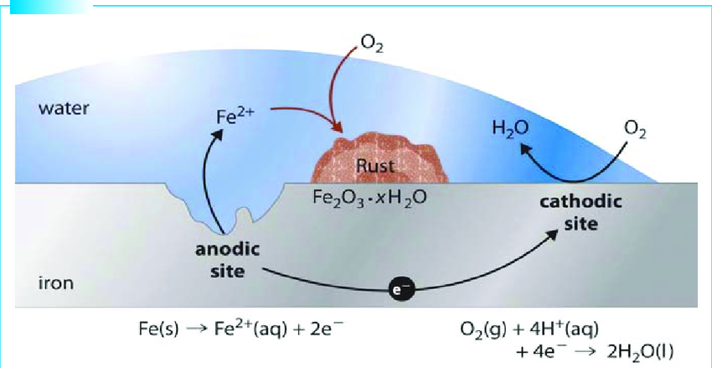
Absorption of Oxygen: This type of corrosion takes place in basic or neutral medium in presence of oxygen.
Usually, the surface of iron is coated with thin film of iron oxide. If the film develops cracks, anodic areas are created on surface and the rest of the metal surface acts as cathodes.
In this condition anodic areas are small and the cathodic areas are large.
Anode: Fe → Fe⁺ + 2e⁺ (Oxidation)
The released electrons flow from anode to cathode through iron metal.
At Cathode: 1/2O₂ + H₂O + 2e⁻ → 2OH- (Reduction)
Over all Reaction: Fe⁺² + 2OH⁻ → Fe(OH)₂
If enough oxygen is present, easily oxidized to ferric hydroxide (Fe₂O₃.2H₂O).

Slide 13
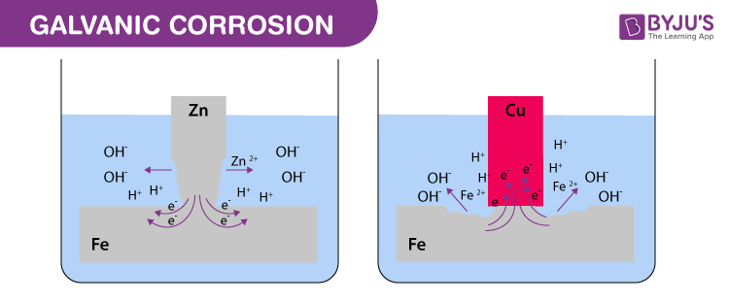
Types of electrochemical corrosion: The electrochemical corrosion is of two types
Galvanic Corrosion:
This corrosion happens, when different metals with varying potentials are in contact.
One metal acts as a cathode whereas the other acts as an anode. This results formation of electrochemical cell.
The anode is dissolved into the electrolyte. This electrochemical process is called galvanic, Bimetallic or Differential metallic corrosion.
Anode
Cathode
Cathode
Anode
Example:
Steel screws in a brass marine hardware.
Lead-antimony solder around copper things
Steel propeller shaft in bronze bearing.
Steel pipe connected to copper plumbing.

Slide 14
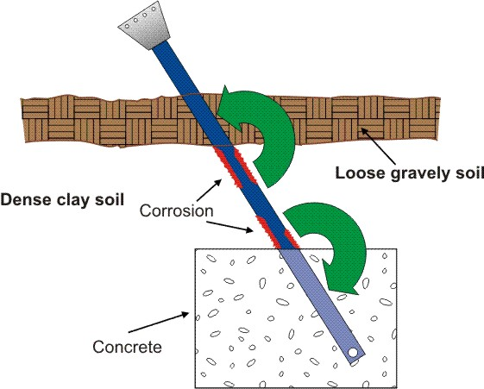
Concentration cell corrosion (Differential Aeration corrosion):
It occurs when a metal is exposed to differential air or oxygen concentration.
Since the cathodic reaction requires oxygen, the part of the metal exposed to higher conc. of oxygen acts as cathode.
The metallic part at lower oxygen conc. acts as anode and corrosion occurs at this region.
Examples of differential aeration corrosions:
Example-1:Water-line Corrosion
Example-2: Pitting corrosion
Example-3: Stress corrosion
Example-4: Cervices corrosion

Slide 15
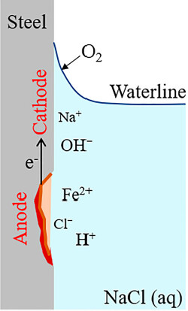
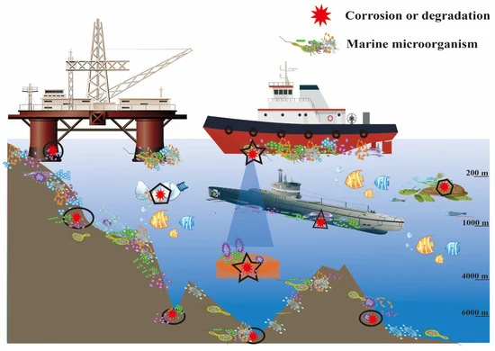
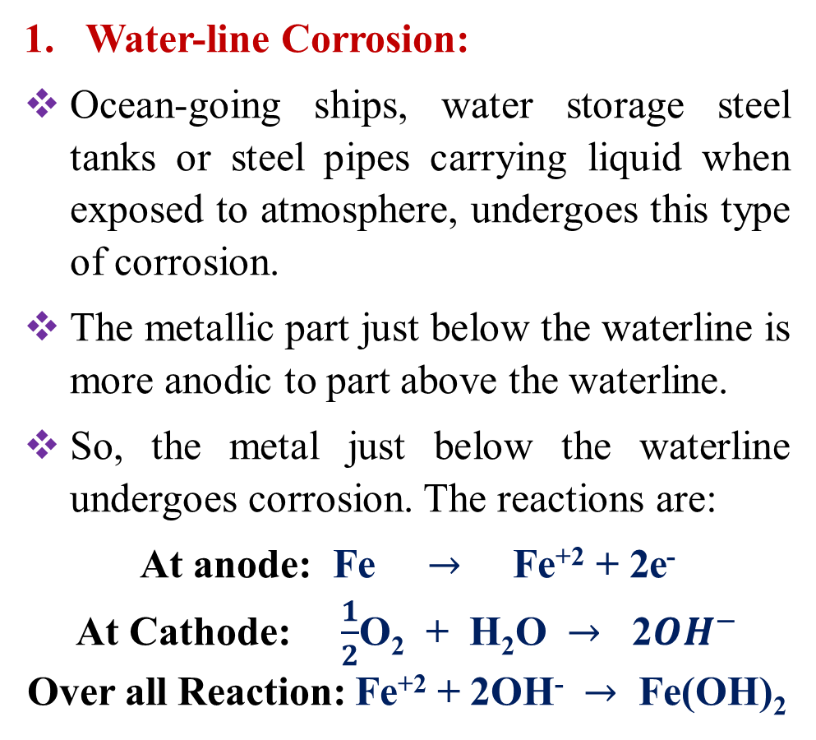
Water-line Corrosion:
Ocean-going ships, water storage steel tanks or steel pipes carrying liquid when exposed to atmosphere, undergoes this type of corrosion.
The metallic part just below the waterline is more anodic to part above the waterline.
So, the metal just below the waterline undergoes corrosion. The reactions are:
At anode: Fe $→$ Fe⁺² + 2e⁻
At Cathode: $\frac{1}{2}$O₂ + H₂O $→$ 2${OH}^{−}$
Over all Reaction: Fe⁺² + 2OH⁻ $→$ Fe(OH)₂

Slide 16
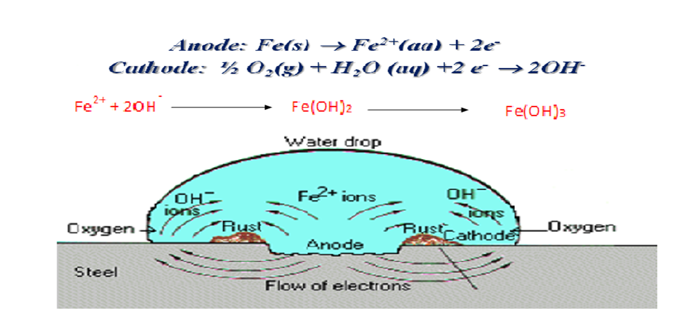
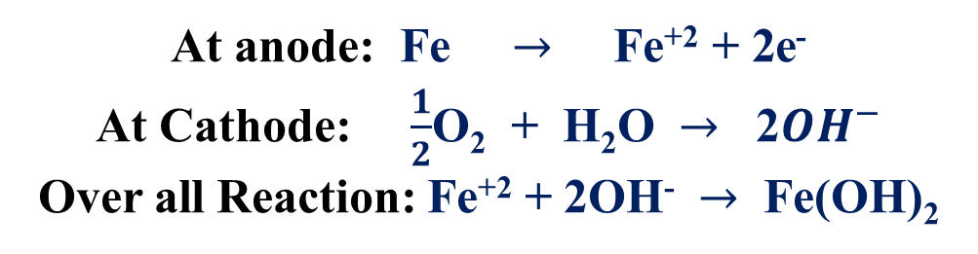
Pitting Corrosion:
It involves localized attack resulting in the formation of cavities.
This corrosion occurs when a small portion of the metal surface is occupied by dust, scale, sand or water drop.
The metal below the water drop or dust deposit is with lower conc. of oxygen, become anode and undergoes corrosion.
Once a pit formed, the rate of corrosion increases.
The accelerated corrosion takes place below the deposit due to small anodic area and large cathodic area.
At anode: Fe $→$ Fe⁺² + 2e⁻
At Cathode: $\frac{1}{2}$O₂ + H₂O $→$ 2${OH}^{−}$
Over all Reaction: Fe⁺² + 2OH⁻ $→$ Fe(OH)₂

Slide 17
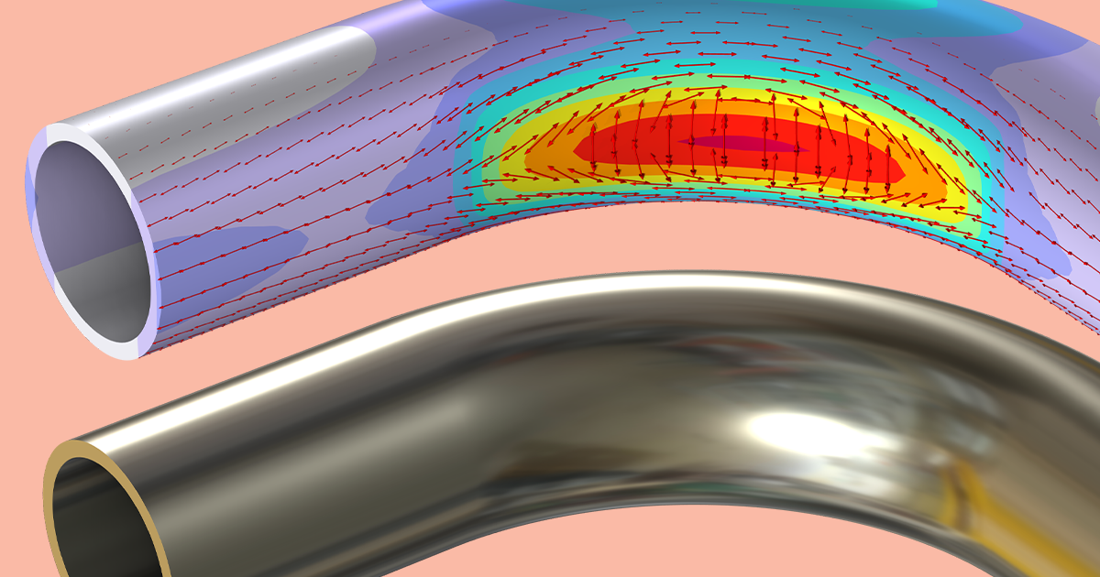
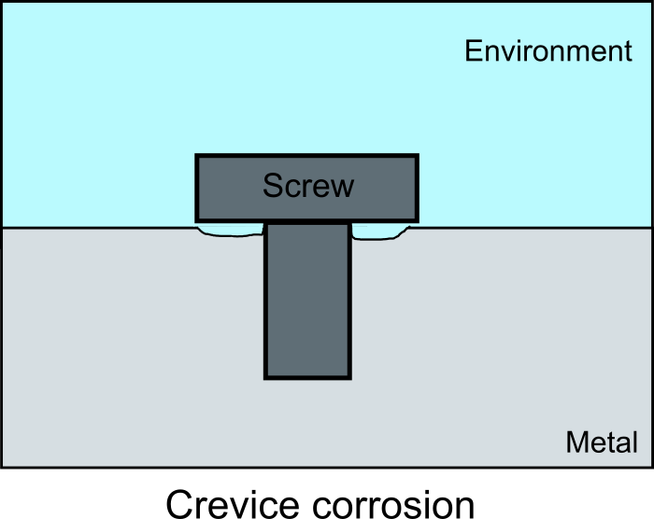
Stress corrosion:
Generally, at bent areas and riveted areas, metal atoms will be under stress.
These stressed areas behave as anodes and the plane surfaces as cathode.
Due to stress corrosion cracks are formed at anode.
Crevice Corrosion
It occurs generally at the crevices between two metallic objects, e.g. bolts, nuts, rivets etc. in contact with liquids.
Crevice area has lack of oxygen and thus becomes anodic region with respect to remaining part of the metal, which acts as cathode.
Crevice corrosion can thus be explained as accelerated attack at the junction of two metals exposed to a corrosive environment.

Slide 18
Differences Chemical corrosion between Electrochemical corrosion:
Chemical (or) Dry corrosion | Electrochemical (or) Wet corrosion
This corrosion occurs at dry conditions. Corrosion is uniform. It is slow process. It involves direct chemical attack of metal by environment. It is explained by absorption mechanism. Corrosion products are produced at the place where corrosion takes place | This corrosion occurs at wet conditions in presence of an electrolyte medium. Not uniform, the anodic area is small, pitting is frequent. It is a rapid process. It involves the formation of large number of electrochemical cells. Explain by mechanism of electrochemical reactions. Corrosion at anode, and corrosion products occurs at cathode.

Slide 19
Factors influencing corrosion
There are two factors that influence the rate of corrosion.
Nature of the metal 2. Nature of the corroding environment
Nature of the metal
Physical state: The rate of corrosion is influenced by physical state of the metal (size, stress). The smaller the grain size of the metal, the greater will be will be its corrosion.
Purity of metal: Impurities: in a metal cause heterogeneity and form minute/tiny electrochemical cells (at the exposed parts), and the anodic parts get corroded.
Position in Galvanic series: The metal higher in series is more active and suffers corrosion. The rate and extent of corrosion is directly proportional to electrode potential difference between them. If alloying metals has large difference in their position in galvanic series, more and fast corrosion happens.
Nature of surface film: Practically all metals get covered with a thin surface film of metal oxide. The ratio of the volumes of the metal oxide to the metal is known as a specific volume ratio. Greater the specific volume ratio, lesser is the oxidation corrosion rate.

Slide 20
Relative areas of the anodic and cathodic parts: When the relative area of anode is small compared to that of cathode, corrosion rate becomes high. It is because of the high anodic current density. For example, any gap on the tin coated iron results in severe corrosion due to small anodic area and large cathodic area.
Solubility of corrosion products: Rate of corrosion is low if corrosion product is insoluble in corroding medium. The product acts as a physical barrier and surpasses further corrosion.
Volatility of the corrosion product: If the corrosion product has volatile nature then rate of corrosion is more. er corrosion resistance than expected from its position in the electrochemical series.
Passivation: The phenomenon in which a metal exhibits a much high is called Passivity. It is due to formation of a protective thin film on the surface of metal and makes it nobler. The film is insoluble, non-porous and of self–healing nature that when broken, it will repair itself on re-exposure to oxidizing conditions. Ex: Ti, Al and Cr.

Slide 21
Hydrogen Overvoltage: Hydrogen overvoltage (hydrogen over potential) is the extra voltage required to drive the hydrogen evolution reaction in acidic medium on a metal surface beyond its theoretical potential. In acidic conditions, the reaction is:
2H⁺+2e⁻ H₂ (g)
Ideally, this should occur at 0 V, but in practice, most metals require a more negative potential to actually produce hydrogen gas. That difference is the hydrogen overvoltage.
Hydrogen overvoltage exists because real surfaces don’t behave like ideal ones. The inefficiency in electron transfer, hydrogen adsorption, and gas formation leads to the need for an extra driving voltage.
High hydrogen overvoltage → hydrogen evolution is difficult → lower corrosion rate for some metals in acidic environments. (e.g., Zn, Pb).
Low hydrogen overvoltage → hydrogen evolution is easy → can lead to higher corrosion rates. (e.g., Pt, Cu).

Slide 22
Nature of Environment
Temperature: The rate of corrosion is directly proportional to temperature ie., rise in temperature increases the rate of corrosion.
Humidity of air: The rate of corrosion will be more when the relative humidity of the environment is high.
Presence of impurities in atmosphere: Atmosphere in industrial areas contains corrosive gases like CO₂, H₂S and SO₂. In presence of these gases the rate of corrosion increases.
Effect of P^{H}: P^{H} value of the medium has greater effect on corrosion. When pH value is lowered, the corrosion is increased.
Nature of electrolyte: This strongly affects the rate because it controls conductivity, availability of ions. A more conductive electrolyte (seawater) allows faster electron/ion transfer, which increases the corrosion rate. Poorly conductive electrolytes (pure water) slow down corrosion.
Conductance of corroding medium: If metal pipe is buried in dry soil, corrosion is less. If it is buried in wet clay containing minerals then corrosion is more.
Formation of oxygen concentration cell: Due to differential aeration, oxygen-concentration cell sets up and anodic part having less oxygen concentration suffers corrosion.

Slide 23
Corrosion control (Protection against corrosion)
As the corrosion process is very harmful, it becomes necessary to control corrosion. Different methods are used to control corrosion. Any method of corrosion control must be aimed at either modifying the metal or the environment.
Cathodic protection.
Protective (Surface) coatings.
1. Cathodic Protection
The principle of cathodic protection involves the conversion of entire metal to behave like cathodic site, since corrosion occurs at anode and cathode remains unaffected.
This can be achieved by two methods as follows:
Sacrificial Anode Method
Impressed Current Method:

Slide 24
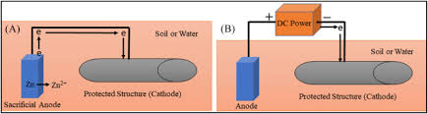
Sacrificial Anode Method
Here, the metal structure to be protected (base metal) is connected to a more active metal, which acts as auxiliary anode and the base metal act as cathode.
Thus, the base metal is protected and corrosion occurs at the auxiliary anodic metal.
Since the anodic metals are sacrificed to protect the metal structure, this method is known as sacrificial anodic method.
New auxiliary anodes replace the exhausted sacrificial anodes, whenever required. The most commonly used sacrificial anodes are Zn, Mg, Al.
For example, to protect the underground pipelines, Mg block is connected to it. Mg bars are fixed to the sides of ocean-going ships for controlling corrosion.
Applications: Protection as buried pipelines, underground cables from soil corrosion.,
Protection from marine corrosion of cables, ship hulls, piers etc,
Insertion of magnesium sheets into the domestic water boilers to prevent the formation of rust.

Slide 25

Impressed Current Method:
In this method, an impressed current from external source is applied in opposite direction to neutralize the corrosion current, and convert the corroding metal from anode to cathode.
This is done by connecting the negative terminal of DC source to the base metal and positive terminal to an inert anode like graphite.
The base metal, being acting as cathode, does not undergo corrosion.
Impressed current cathodic protection has been applied to open water box coolers, water tanks, buried oil or water pipes, condensers, transmission line towers, marine piers, laid up ships etc.
This kind of protection technique is particularly useful for large structures for long term operations.

Slide 26
Surface treatment
Almost all metal things must be cleaned during their manufacturing. These are processes that affect thin layer on the metallic surface. The surface treatments processes includes:
Chemical cleaning methods: Use chemicals to remove unwanted contaminants on metals.
Alkaline cleaning
Acid cleaning
Emulsion cleaning
Solvent cleaning
Ultrasonic cleaning
Mechanical cleaning methods: Use mechanical operations to remove contaminants on metals.
Blast finishing
Shot peening
Mass finishing processes

Slide 27
Chemical cleaning methods
Alkaline Cleaning:
Uses alkali to remove oils, grease, and various types of silica, scales from a metal surface.
Alkaline solutions include sodium and potassium hydroxide (NaOH, KOH), sodium carbonate (Na₂CO₃), borax (Na₂B₄O₇).
Cleaning methods: immersion or spraying followed by water rinse to remove residue.
Acid pickling:
In this process a solution of a mineral acid, organic acid combination are used to remove oxide, soil particles, oil, rusts and grease from metal surfaces.
Cleaning acids include HCl, HNO₃, H₃PO₄, and H₂SO₄.
Emulsion (Soap) Cleaning:
Emulsion cleaning is cleaning process that uses an organic solvent mixture.
The solvent is usually a hydrocarbon of distilled petroleum dispersed in water.
Suitable emulsifiers result in a two-phase cleaning fluid like oil-in-water.

Slide 28
Solvent cleaning:
Solvent cleaning is the process of removing soil particles from metal surface with an organic solvent.
Some examples of strong cleaning solvents are acetone, methyl ethyl ketone, toluene and trichloroethylene (TCE).
Common mild solvents include isopropyl alcohol, glycerin, and propylene glycol.
Ultrasonic cleaning:
Mechanical agitation of cleaning fluid by high frequency vibrations to produce of low-pressure vapor bubbles that scrub the surface.
Cleaning fluid is generally an aqueous solution containing alkaline detergents.
Highly effective for removing surface contaminants.

Slide 29
Mechanical cleaning methods
Blast Finishing:
Use high velocity impact of particulate media to clean and finish the surface.
Media is propelled at the target surface by pressurized air or centrifugal force.
Most well-known method is sand blasting, which uses sand as blasting media.
Other blasting media: Hard Al₂O₃ and SiC, Soft media such nylon beads.
Shot Peening:
High velocity stream of small cast steel pellets (shots) is directed at the surface to induce compressive stresses into surface layers.
Used primarily to improve strength of metal parts surface cleaning is accomplished as a byproduct of the operation.
Mass Finishing:
Finishing parts in bulk by a mixing action in a container, in the presence of abrasive media.
Mixing causes parts to rub against media each other to achieve desired finishing action.
Parts are usually small and therefore uneconomical to finish individually.

Slide 30
Hardening
Hardening of metal is a heat treatment process used to increase the hardness and strength of a metal, especially steel.
The goal is to make the material more resistant to wear, deformation, and scratching by changing its internal structure.
Mechanical hardening of the surface:
This is the process of strengthening a metal by plastic deformation, which alters its internal grain structure and increases dislocation density. This increasing hardness and strength.
Examples of these processes include:
Shot peening: small spherical media (shots) blasted onto the surface of metal at high velocity.
Water-jet peening: uses high-pressure water jets to induce compressive residual stress.
Laser peening: uses powerful laser pulses to create compressive residual stresses.
Explosive hardening: Layer of explosive coated on the surface is blasted.

Slide 31
Case hardening:
Case hardening is a heat treatment process used to harden the surface of a metal while leaving the core relatively soft.
This process is often applied to steel and other ferrous.
The result is a material with a tough, hard exterior that can withstand abrasion and wear.
The case hardening process generally involves the following steps:
Carburizing (Carbon Enrichment): The metal is heated in a furnace with a carbon-rich environment (CO , Charcoal or Carbon powder). During this process, carbon atoms diffuse into the surface of the metal, leaving the inner core of the metal largely unaffected.
Heating and Quenching: After the carbon has diffused into the surface, the material is rapidly heated to a high temperature and then quenched (usually in water or oil). The quick cooling process hardens the surface layer.
Tempering: After quenching, the material is tempered (heated to a lower temperature and slowly cooled) to reduce brittleness.

Slide 32
Case hardening methods
Carburizing | This is a heat treatment process where carbon is added to the surface of low-carbon steel to harden it. To improve wear resistance on the surface. To maintain toughness and shock resistance in the core.
Carbonitriding | This is combination of carburizing and Nitriding. This is improving both wear resistance and fatigue strength.
Cyaniding | This is a process in which a metal part is heated in a molten bath of sodium or potassium cyanide. The result is a thin, hard surface layer enriched with carbon and nitrogen
Nitriding | This process involves heating the metal in the nitrogen to form hard nitrides at the surface. Nitriding provides a very hard, wear-resistant surface.
Boronizing | This is a process in which boron atoms are diffused into the surface of a metal component at high temperatures. This significantly increasing the surface hardness, wear resistance, and corrosion resistance.

Slide 33
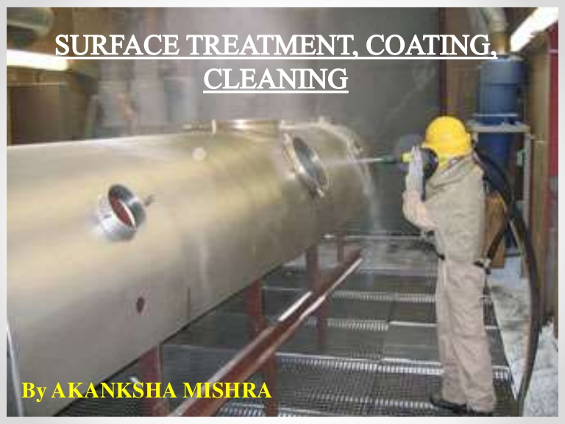
Surface coatings-Metallic coatings
Surface coating made up of metals called metallic coatings.
Metallic coatings are produced by coating one metal on the surface of another metal.
The metal which has to be protected is base metal and the metal which has to be coated is coating metal.
The metallic coatings often used are of zinc, tin, nickel, chromium, aluminum and copper.
These are of two types:
Anodic coatings
Cathodic coatings

Slide 34
Anodic coatings:
In these coatings, the metal used as coating is more anodic than the base metal.
A characteristic feature of anodic coating is that even if the coating falls off at some places due to pores and cracks, the base metal does not undergo corrosion as the base metal is cathodic in nature.
Base metal not corroded, till all the coating metal which behaves like anode is consumed.
Ex: - Coating of Zn, Al and Cd anodic metals coated on the surface of steel. Galvanization is one type of anodic coating technique.
Cathodic coating:
These coatings are produced by coating base metals with more noble metals.
Cathodic coatings are effective only when coatings are continuous, nonporous, free from gaps.
Otherwise, rapid corrosion of the metal takes place as a result of formation of large cathodic and small anodic areas. Tinning is an example of this category.

Slide 35
Differences between Anodic and Cathodic coatings
Anodic Coating | Cathodic Coating
Protects the underlying base metal sacrificially. Reduction potential of coating metal is lower than that of the base metal. If pores, breaks or discontinuities occur in the coating, the base metal is not corroded until all the coating metal is consumed. Coating of Zn on iron is an example. | Protects the underlying base metal due to its higher corrosion resistance. Reduction potential of coating metal is higher than that of the base metal. If pores, breaks or discontinuities occur in the coating, the corrosion of the base metal gets speeded up. Coating of Sn on iron is an example.

Slide 36
Protective Coatings
In order to protect metals from corrosion, it is necessary to cover the surface by means of protective coatings.
These coatings act as a physical barrier between the coated metal surface and the environment.
They afford decorative appeal and impart special properties like hardness, oxidation resistance and thermal insulation.
Protective coatings can be broadly classified into two types.
They are 1. Metallic coatings 2. Organic coatings (Paints)
Metallic Coating
Hot dipping (Galvanizing and Tinning).
Metal cladding (Aluminium cladding).
Electroplating (Cupper plating).
Electroless plating (Nickel plating).
Electroforming.
Thermal spraying.
Vapour deposition.
Ion implantation.
Diffusion coating.

Slide 37
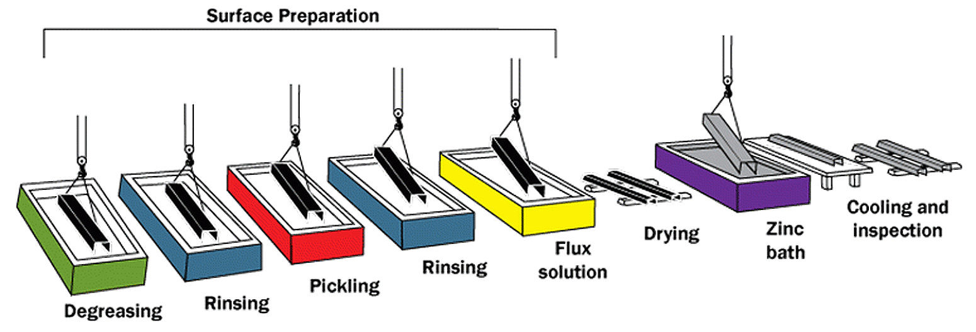
Hot Dipping
This is a method of coating a low melting metal such as Zn, Sn, Pb, Al, etc., on iron, steel and copper which have relatively higher melting points.
The base metal is dipped in a molten bath of the coating metal which is covered by a molten flux layer which cleans the base metal surface and prevents the oxidation of the coating metal.
For good adhesion of the coating metal on the surface of base metal, the base metal surface must be very clean.
The most commonly used hot dipping methods are Galvanizing and Tinning.
Metal

Slide 38
A. Galvanizing:
It is a process of coating iron or steel sheets (Cathodic in nature) with a thin coat of Zinc metal (Anodic in nature) to prevent iron from rusting.
The base metal iron or steel sheet is cleaned by acid pickling method with dil.H₂SO₄ for 15-20 minutes at 60-90ºC.
The sheet is then washed well and dried. It is dipped in a bath of molten Zinc maintained at 425º - 435ºC.
The surface of the bath is kept covered with ammonium chloride flux to prevent oxide formation.
The sheet is taken out and excess Zn is removed by passing it between a pair of hot rollers.
Then the sheet is subjected to annealing process at 650ºC and cooled slowly.
An alloy of iron and zinc were formed at the junction of the base metal and coating metal.
Applications:
It is used to protect iron used for roofing sheets, wires, pipes, bolts, buckets and tubes.
Galvanizing utensils cannot be used for preparing and storing food stuffs, in acidic conditions zinc dissolves to form highly toxic compounds.

Slide 40
B. Tinning:
Coating tin (Cathodic in nature) over iron or steel (Anodic in nature) articles is called tinning.
In this process the surface of the base metal i.e., iron sheet is cleaned by acidic pickling with dil.H₂SO₄ and passed through a bath of zinc chloride flux.
The flux helps the molten metal to adhere to the metal surface. Then the sheet is passed through molten tin bath and pressed in between two rollers from a layer of palm oil.
Palm oil helps to protect the tin coated surface against oxidation.
The rollers remove excess of tin and produce a thin film of uniform concentration an alloy of the base metal, coating metal at their junction.
Applications:
1. Tin metal possess good resistance against atmospheric corrosion. Tin is non toxic and widely used for coating steel, copper, and brass sheet.
2. The containers coated with tin is used for storing food stuffs, ghee, oils etc. and packing food materials.
3. Tinned copper sheets are used for making cooking utensils and refrigeration equipment.

Slide 41
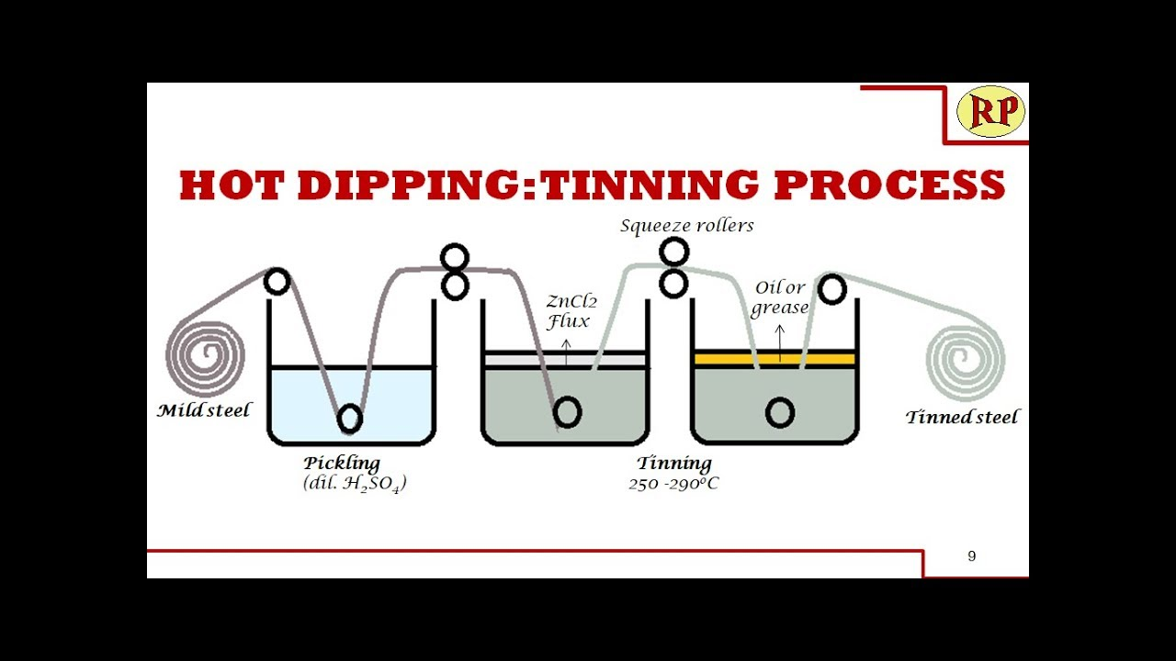

Slide 42
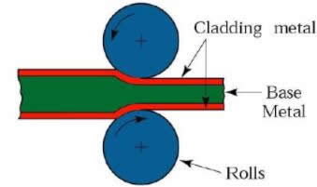
Metal cladding (Al Cladding):
In metal cladding the base is sandwiched between two sheets of coating metal by passing through roller under the action of heat and pressure.
In this process a dense, homogeneous layer of coating metal is cladded firmly and permanently to the base metal on one or both sides.
The metals like Ni, Cu, Pb, Ag, Pt and their alloys stainless steel are used as cladding materials.
The common base metals cladded are mild steel, aluminium, copper, nickel and their alloys.
Duralumin is an alloy 95% aluminium, 4% copper, 0.5% manganese and 0.5% magnesium.
A 99.5% pure aluminium is subjected to cladding to protect Duralumin to produce Al-clad.
Applications: This method is widely adopted in aircraft industry and automobile industry.

Slide 43
3. Electro plating (or) electrodepositing (Copper plating):
This is a process where a metal layer is deposited onto the surface of another material (usually metal) using electric current.
It enhances appearance, corrosion resistance, wear resistance, and electrical conductivity.
The object to be plated is the cathode. The plating metal is the anode. The electrolyte is a solution containing metal ions of the plating material.
Electroplating-Copper plating:
Electroplating with copper is a process where a thin layer of copper is deposited onto the surface of another material using electric current.
Cathode: The object to be plated
Anode: Pure copper.
Electrolyte: Copper sulfate solution with sulfuric acid.
Reaction: Copper dissolves from the anode into the solution as Cu²⁺ ions. Cu²⁺ ions move to the cathode and are reduced to form metallic copper on the object’s surface

Slide 44
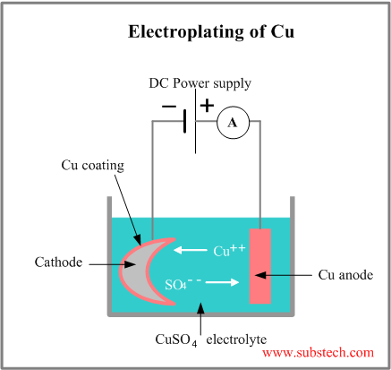
Anode: Cu(s) Cu²⁺(aq) + 2e⁻
Cathode: Cu²⁺(aq) + 2e⁻ Cu(s)
Application:
Electroplating is a most important and frequently used technique in industries to produce metallic coatings.
Both metals and non metals can be electroplated.
In non metals electroplating increases strength and decorates the surface of non metals like plastics, wood, glass etc.

Slide 45
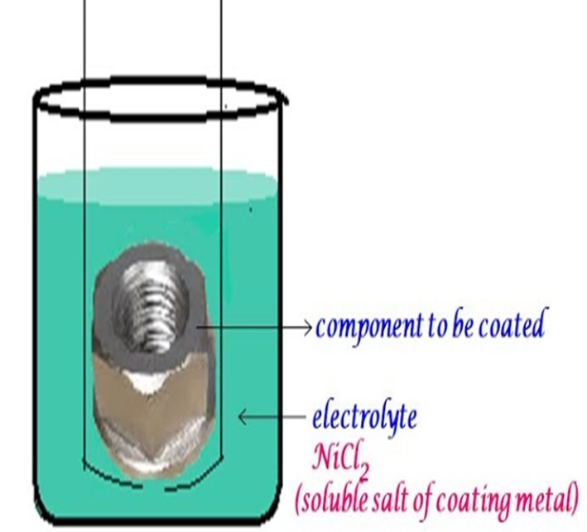
4. Electroless plating (Nickel-plating):
Electro-less plating is a chemical method to deposit a metal coating onto a surface without using electricity. Instead, it relies on a controlled chemical reduction reaction in a solution.
The surface is cleaned and activated. It's immersed in a plating bath containing Metal ions (Ni²⁺), A reducing agent (sodium hypophosphite).
The reducing agent chemically reduces the metal ions onto the surface. A uniform, even metal layer forms on base metal surface.
Composition bath
Coating solution: NiCl₂ solution.
Reducing agent: Sodium hypophosphite.
Buffer: Sodium acetate.
Reactions: Ni²⁺+H₂​PO₂−​→Ni (solid)+By-products
Electro-less nickel plating enhances corrosion resistance, hardness, and wear properties, ideal for intricate and non-metallic components.

Slide 46
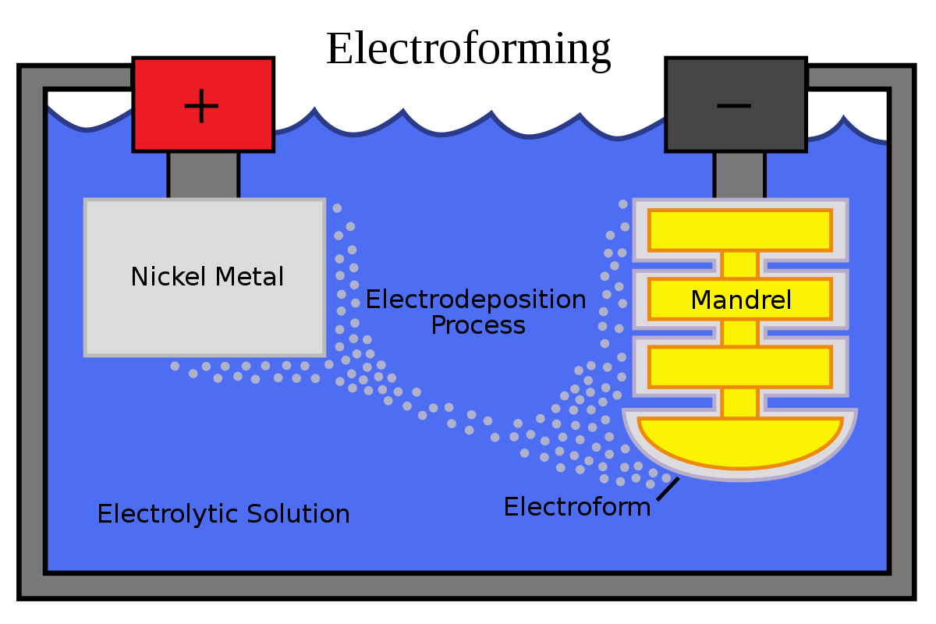
5. Electroforming:
Electroforming is the process of building up a metal object by electro deposition onto a mold (mandrel), which is later removed to leave a freestanding metal part.
Purpose: Manufacture precise, often delicate or complex metal parts.
The mold (mandrel) is often removed—the deposited metal becomes the product itself.
Deposit is thicker, often hundreds of microns to millimeters.
Example: Making metal mesh filters, precise optical parts, or micro machined components. Process:
Mandrel is the cathode.
Electrolyte contains metal ions.
After deposition, mandrel is removed (chemically, thermally, or mechanically).

Slide 47
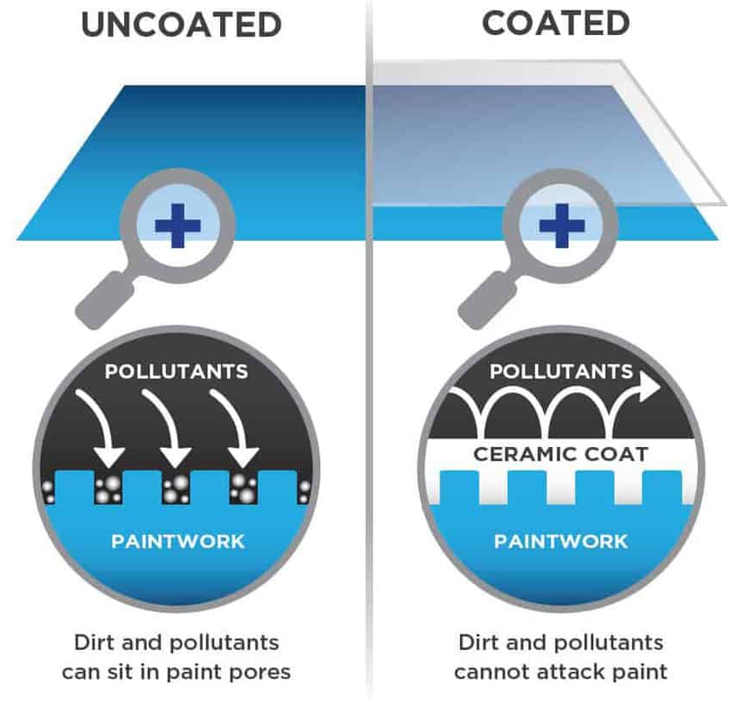
6. Ceramic coating:
Ceramic coating is a thin layer of inorganic material, typically containing ceramic compounds like silicon dioxide (SiO₂) or titanium dioxide (TiO₂), applied to surfaces to provide protection, durability, and performance benefits.
It can be applied to metals, plastics, glass, or paint.
Applied as a liquid or sprayed-on coating, then cured (air-dried or heat-treated) to form a hard, durable layer.
Ceramic coating is a tough, protective layer that shields surfaces from heat, chemicals, corrosion, and wear, widely used in industries from automotive to aerospace.

Slide 48
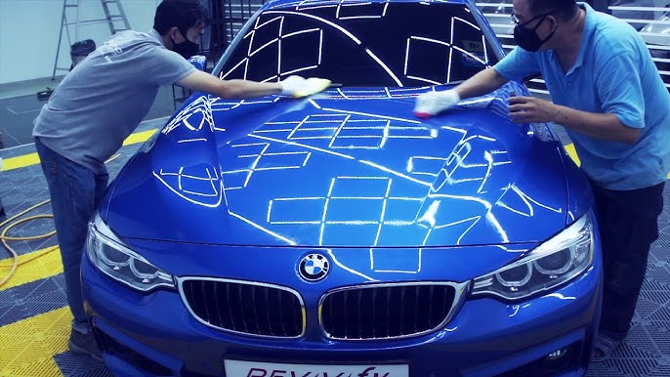
7.Diamond coating:
Diamond coating is a thin layer of diamond or diamond-like material applied to a surface to significantly improve hardness, wear resistance, thermal conductivity, and chemical stability.
The coating is typically made of:
Crystalline Diamond (true diamond structure).
Diamond-Like Carbon (DLC) amorphous carbon with properties similar to diamond.
These coatings are applied using advanced processes like:
Chemical Vapor Deposition: for real diamond coatings.
Physical Vapor Deposition: often used for DLC films.
This coating brings the super-hard, durable, and chemically resistant properties of diamond to tools and components.
Ex: cutting tools, heat spreaders, Automotive, medical, electronics.

Slide 49
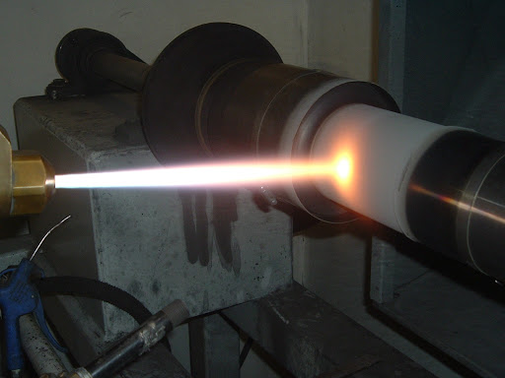
8. Thermal spraying:
Thermal spraying is a surface coating process where molten or semi-molten materials are sprayed onto a surface to form a protective or functional coating
In thermal spraying, material (usually a powder or wire) is heated using a high-temperature energy source (like a flame, electric arc, or plasma), then propelled at high speed onto a prepared surface. The particles flatten and solidify, forming a dense, well-adhered coating.
Main Benefits: Wear resistance (abrasion, erosion), Corrosion resistance, Thermal insulation (or conductivity), Electrical insulation or conductivity and Repair of worn components

Slide 50
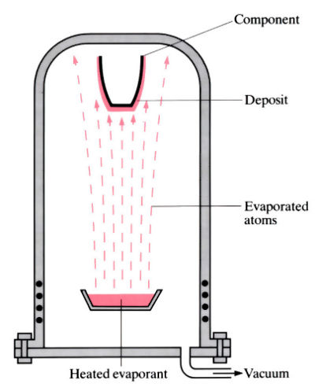
9. Vapour deposition:
This is a thin film coating process in which a material is converted into a vapor phase and then condensed onto a solid surface, forming a very thin, uniform coating.
It’s widely used in electronics, optics, aerospace, and medical devices to deposit Metals (gold, titanium) Ceramics (TiN, SiO₂), Polymers.
Vapour deposition is a precise method for applying extremely thin, high-performance coatings to surfaces—used heavily in advanced manufacturing.
Applications: Microchips & semiconductors, Cutting tools , Solar panels, Optical lenses, Medical implants.

Slide 51
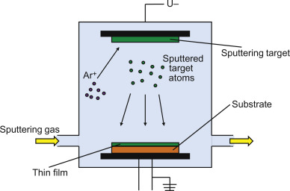
10. Ion implantation:
This is a surface modification method where ions of a material are accelerated into a solid surface to change its physical, chemical, or electrical properties without adding a coating.
A gas (nitrogen, boron, or phosphorus) is ionized. These ions are accelerated using an electric field and bombarded into a target material (metal, ceramic, or semiconductor).
The ions penetrate the surface and embed into the material at the atomic level.
No coating is formed – the surface is modified internally. Depth of modification is few nanometers to micrometers. Usually done in a vacuum chamber.

Slide 52
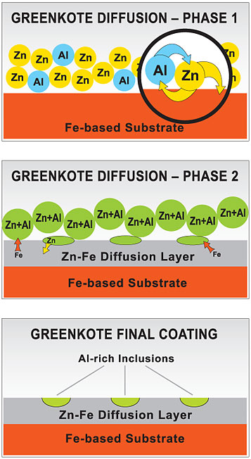
11. Diffusion Coating:
This is a surface treatment in which atoms from a coating material diffuse into the surface of a metal at high temperature, creating a gradual transition between the surface and the substrate.
A coating element (aluminum, chromium, boron, or silicon) is placed in contact with the base metal.
The part is heated (800–1100°C) in a controlled atmosphere. The atoms diffuse into the metal surface, forming intermetallic compounds or solid solutions.
This creates a hard, corrosion-resistant, or oxidation-resistant surface layer.
Diffusion coating enhances the surface properties of metals by infusing alloying elements into the surface at high temperatures, improving performance without applying a traditional "coating layer.

Slide 53
Organic coatings:
These are materials applied to surfaces, typically metals, to provide a protective layer that prevents corrosion, wear, or other forms of degradation. They are made from organic polymers, which can be derived from natural or synthetic materials.
Types of Organic Coatings:
1. Paints: Paint is typically consists of pigments, binders, solvents, and additives.
Pigments provide color and opacity.
Binders hold the pigment particles together and bind them to the surface.
Solvents dissolve the binder to create a liquid that can be easily applied.
Additives enhance properties like drying speed, UV resistance, or corrosion protection.
2. Varnishes: Varnishes are clear coatings that do not contain pigments. They provide a glossy finish and are often used to protect wood, metals, and other materials.
3. Polymer Coatings: These are coatings made from specific organic polymers such as epoxy, polyurethane, acrylic, or polyester. They offer various levels of hardness, flexibility, and resistance to chemicals, heat, and abrasion.

Slide 54
Long Answer Questions
What is Corrosion? Discuss causes and effects of corrosion.
Describe mechanism of electrochemical theory of corrosion.
Describe mechanism of oxidation corrosion.
What is electrochemical corrosion? Explain the electrochemical corrosion in terms of hydrogen evaluation and oxygen absorption mechanism.
Explain the various factors influencing the rate of corrosion.
Discuss the role of metal oxide formed in oxidation corrosion with the help of Pilling Bedworth rule.
How corrosion is protected by catholic protection?
Explain the mechanism of wet corrosion.
Write short notes on: (a) Electroplating (b) Galvanization and tinning (c) Electroless plating.
Explain the difference in the use of anodic and cathodic coatings for corrosion protection.
Illustrate various types of electro corrosion.
Differentiate chemical corrosion from electrochemical corrosion.

Slide 55
Short answer Questions
What is corrosion of metals? Give examples.
Interpret Pilling-Wedworth rule.
Iron corrodes faster than aluminium, even though iron is placed below aluminium in the electrochemical series. Why?
Rusting of iron is quicker in saline water than in ordinary water. Why?
Why does corrosion occur in steel pipe connected to copper plumbing?
What do you mean by galvanic corrosion?
Why does corrosion of water filled steel tanks occur below the waterline?
What is meant by term passivity?
Why does impure metal corrode faster than pure metal?
A copper equipment should not possess a small steel bolt. Why?
Analyze effect of corrosion product on rate of corrosion.
Simplify liquid metal corrosion.
Write short notes on pitting and cervices corrosion.
Compare anodic coatings with cathodic coatings.
Define Metal cladding and Hot dipping.

Slide 56
Simplify differential aeration corrosion.
What are organic coatings?
Write a short notes on constituents of paints.
Compare diffusion coating with hot dipping.
Compare electroplating with electroforming.
List some factors related to environment effecting rate of corrosion.
Why does small anodic and large cathodic areas favorable to corrosion?

